Slide 1
Lesson 6: Unsupervised Learning

Slide 2
Today's Agenda
Clustering
Concept of Clustering
Distance Measures
Hierarchical Clustering
K-means Clustering
Clustering Evaluation

Slide 3
Learning Objectives
By the end of this session, you should be able to:
Identify use cases for unsupervised learning.
Explain the effects of applying different distance metrics.
Apply K-means to benchmark data and evaluate the quality of the clusters.
Apply hierarchical clustering to benchmark data and evaluate the quality of the clusters.

Slide 4
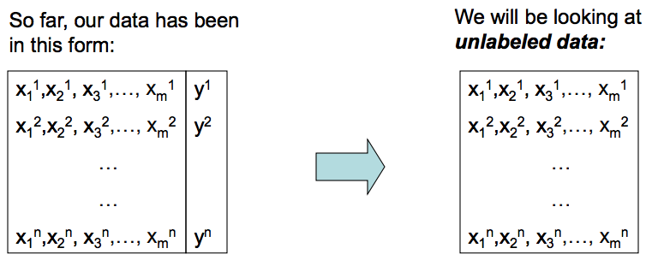
Unsupervised Learning
What do we expect to learn from such data?
I have tons of data (web documents, gene data, etc) and need to:
organize it better – e.g., find subgroups
understand it better – e.g., understand interrelationships
find regular trends in it – e.g., If A and B, then C

Slide 5
Clustering
Clustering: Organization of unlabeled data into similar groups (subsets).
Cluster: A collection of data where the items in the collection are similar to one another and are dissimilar to other collections of data.
What are good clusters?
Maximize the similarity within objects in the same group.
Maximize the difference between objects in different groups.

Slide 6
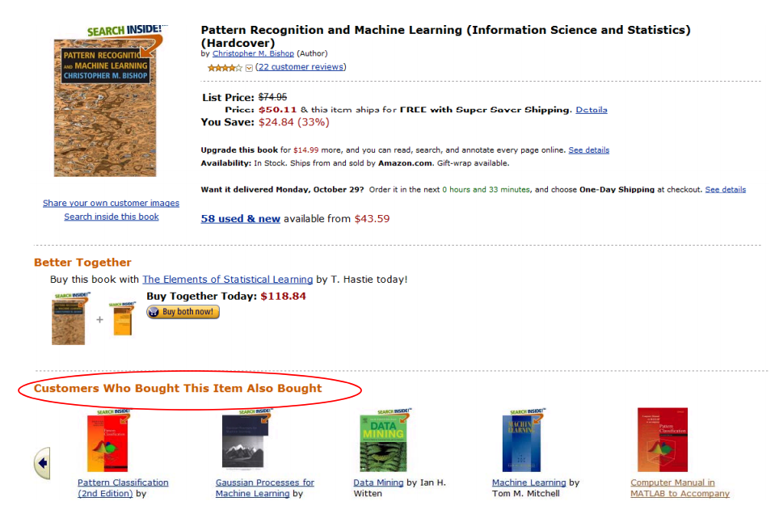
Recommendations

Slide 7
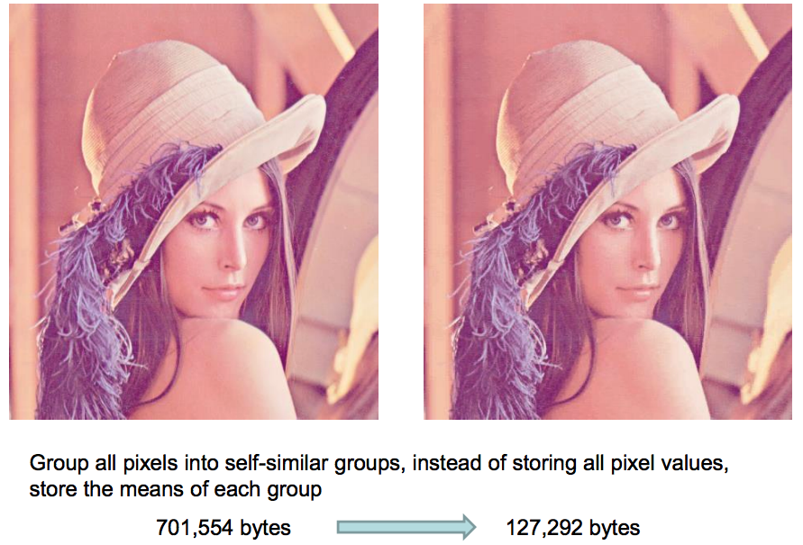
Image compression: Vector quantization

Slide 8
Applications
Information retrieval: cluster retrieved documents to present more organized and understandable results
Consumer market analysis: cluster consumers into different interest groups so that marketing plans can be specifically designed for each individual group
Image segmentation: decompose an image into regions with coherent color and texture
Vector quantization for data (i.e., image) compression: group vectors into similar groups, and use group mean to represent group members
Computational biology: group gene into co-expressed families based on their expression profile using different tissue samples and different experimental conditions

Slide 9
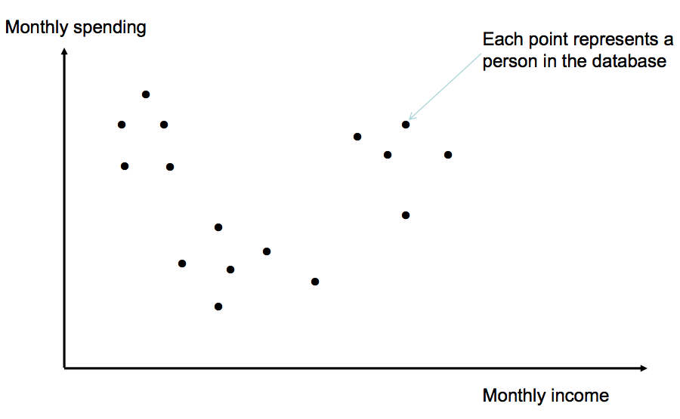
A Hypothetical Clustering Example

Slide 10
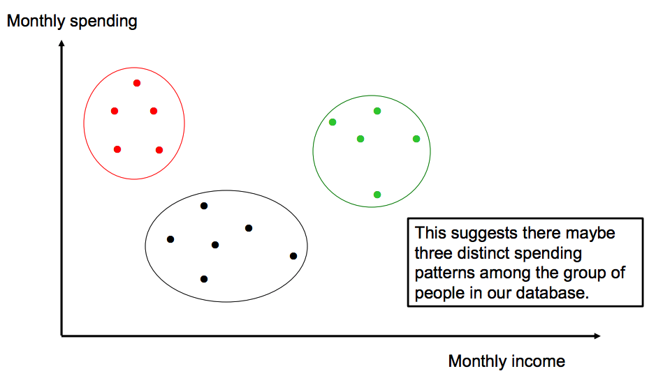
A Hypothetical Clustering Example

Slide 11
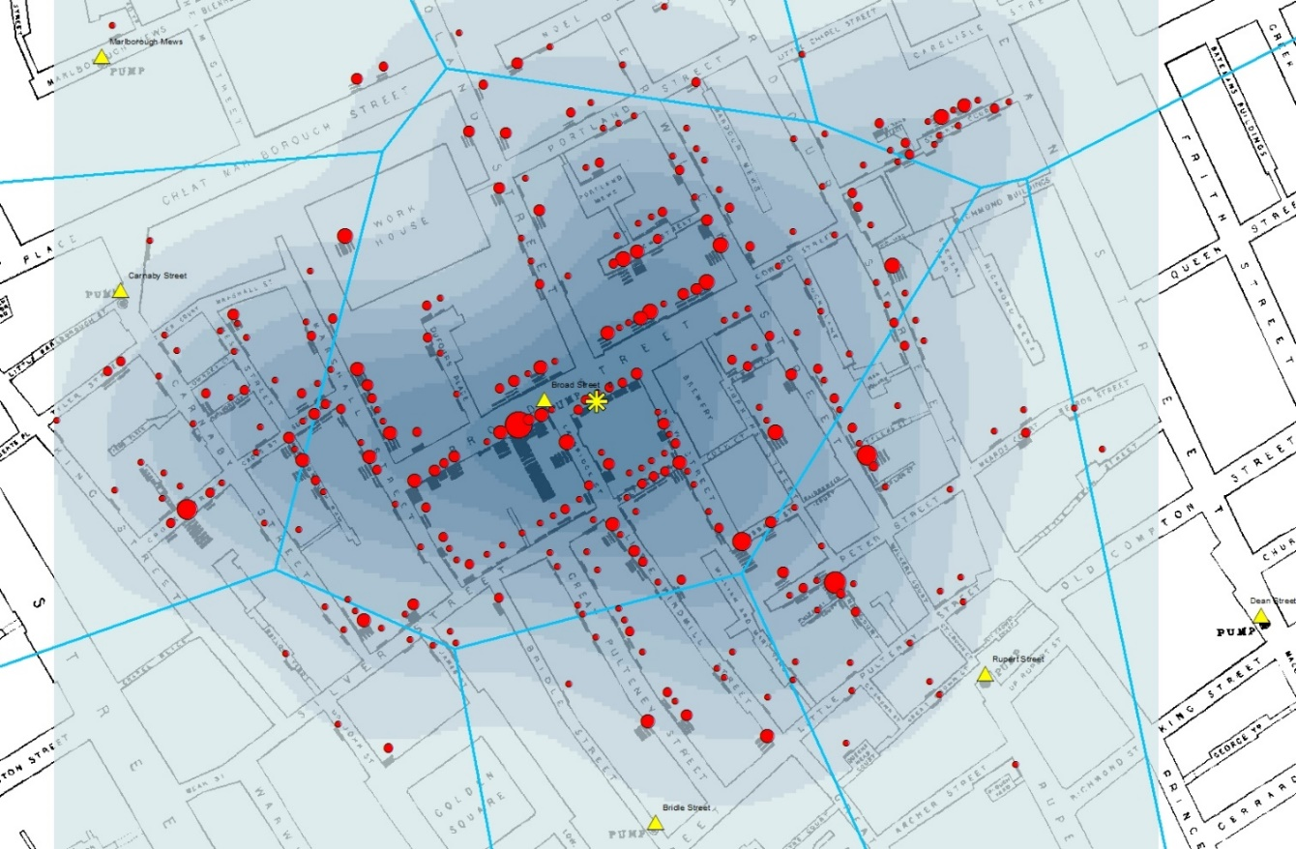
John Snow’s Cholera Study (1854)
One of the earliest known examples of using clustering for data analysis is the pioneering study of cholera outbreak in Soho, London in 1854.
Collected data on cholera instances and their proximity to water pumps.
Outbreaks were clustered around water pumps with some exceptions.

Slide 12
Important Components in Clustering
Distance/similarity measures (aka proximity measures)
Measures to determine how similar or different are instances to one another.
Clustering algorithm
Algorithm to find the clusters based on the distance/similarity measures.
Evaluation Criteria
Metrics to tell if one form of clustering is better than another form.

Slide 13
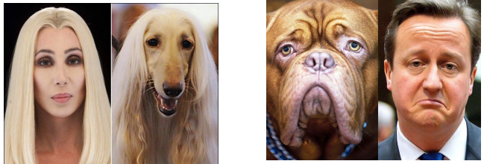
Distance/similarity Measures
One of the most important question in unsupervised learning, often more important than the choice of clustering algorithms.
What is similarity?
Similarity is hard to define, but we know it when we see it.
More pragmatically, there are many mathematical definitions of distance/similarity.

Slide 14
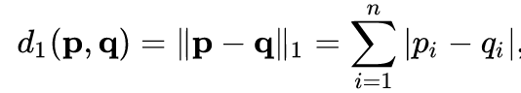
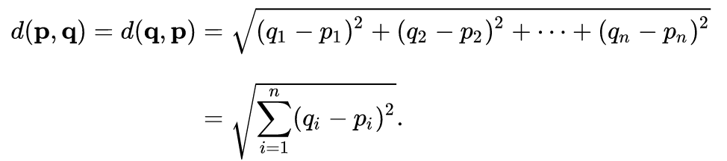
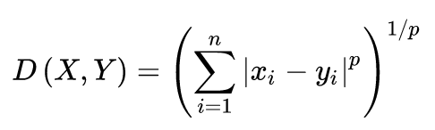
Distance/Similarity Measures
Manhattan Distance:
Euclidean Distance:
Minkowski Distance

Slide 15
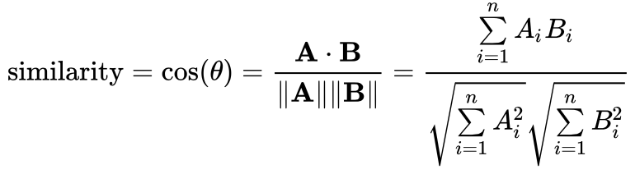
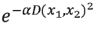
Distance/Similarity Measures
Inner Product Space: The angle between two vectors as a distance metric. It is especially useful when clustering high dimensional data
Chebychev Distance: Two vectors are different if they are different on any one of the attributes.
We can always transform between distance and similarity using a monotonically decreasing function. For example.

Slide 16
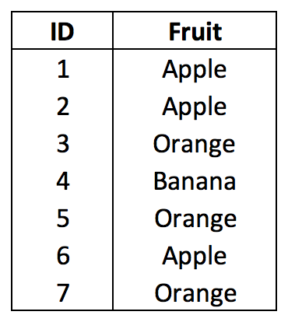
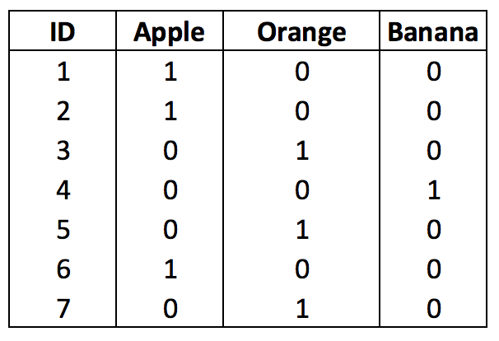
Distance Metrics on Nominal Values
Hamming Distance: The minimum number of substitutions required to change one string into the other d_{ham}(karolin,kathrin) = 3, d_{ham}(1010, 1000) = 1
Convert to Numeric using one-hot encoding:

Slide 17
How to decide which to use?
It is application dependent.
Consider your application domain, you need to ask questions such as:
What does it mean for two consumers to be similar to each other? Or for two genes to be similar to each other?
For example, for text domain, we typically use cosine similarity.
This may or may not give you the answer you want depends on your existing knowledge of the domain.
Clustering is an exploratory procedure and it is important to explore – i.e., try different options and see what makes sense.

Slide 18
Clustering Algorithms
Hierarchical algorithms build a tree-based hierarchical taxonomy (dendrogram).
Bottom up
Top down
Partition (Flat) algorithms produce a single partition of the unlabeled data.
K-means
Mixture of Gaussian

Slide 19
Hierarchical Clustering

Slide 20
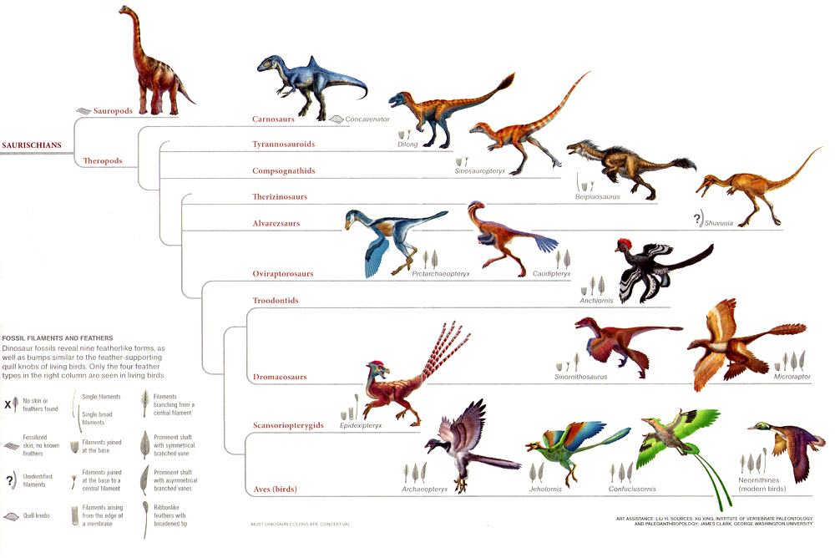
Hierarchical Clustering
Goal: Build a hierarchy of clusters
Agglomerative Clustering: (Bottom up approach)
Each instance is its own cluster
Pairs of clusters are merged as one moves up the hierarchy until there is only one cluster
Divisive Clustering: (Top Down approach)
All observations start as one cluster
Recursively split the data as one moves down the hierarchy until each instance is a cluster

Slide 21
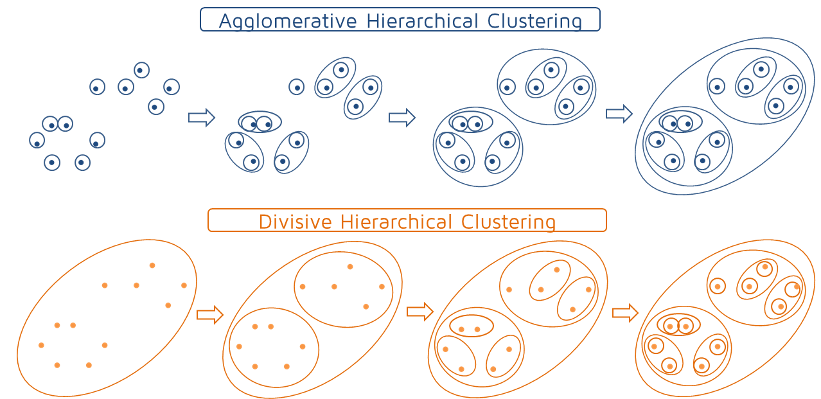
Types of Hierarchical Clustering

Slide 22
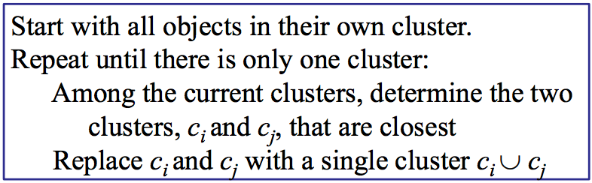
Hierarchical Agglomerative Clustering Algorithm
Problem: we assume a distance/similarity function that computes distance/similarity between examples, but here we also need to compute distance between clusters.

Slide 23
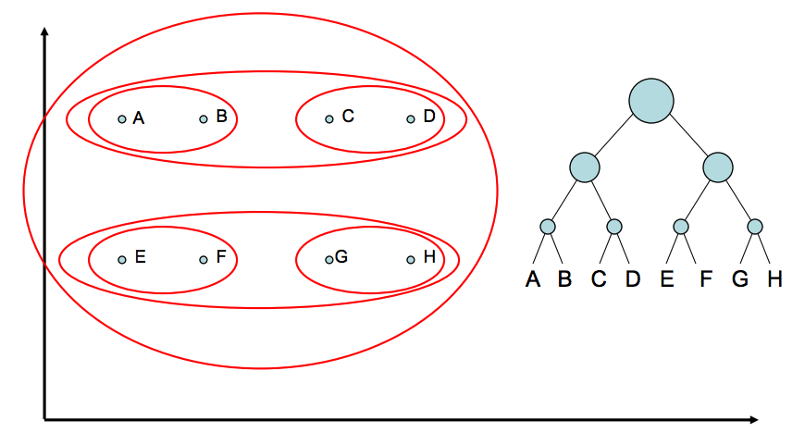
HAC Example

Slide 24
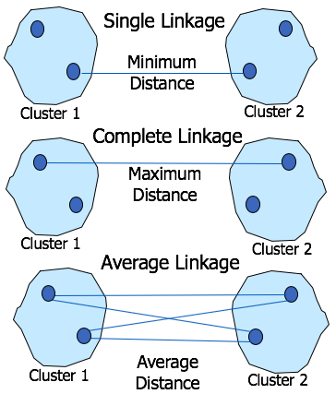
Distance Between Clusters
Single Link: The distance between two clusters is the distance between two closest points in the two clusters, one from each cluster. Can result in long chains of clusters
Complete Link: The distance between two clusters is the distance of two furthest data points in the two clusters. Sensitive to outliers
Average Link: the distance between two clusters is the average distance of all pair-wise distances between the data points in two clusters

Slide 25
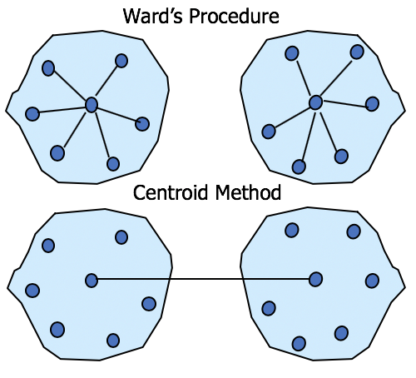
Distance Between Clusters
Ward's Procedure: For each cluster calculate the sum of squares. The two clusters with the smallest increase in the overall sum of squares within cluster distances are combined.
Centroids Method: The distance between two clusters is the distance between their centroids.
In general, the average linkage and Ward's methods have been shown to perform better than others.

Slide 26
Updating the Cluster Distances
After merging c_{i} and c_{j}, the distance of the resulting cluster to any other cluster, c_{k}, can be computed by:
Single Link:
Complete Link:

Slide 27
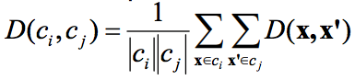
Updating the Cluster Distances con’t
Average Link: average similarity between members of the two clusters.
Averaged across all pairs between the original two clusters
Compared to single link and complete link:
Computationally more expensive – O(n₁n₂)
Achieves a compromise between single and complete link

Slide 28
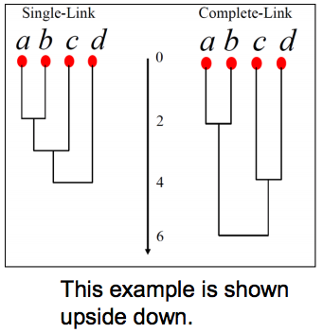
Dendrogram: Cluster Visualization
Height of the joint = the distance between the two merge clusters.
The merge distance monotonically increases as we merge more and more for
Single, complete and average linkage methods
Not for the centroid method
This can provide some understanding about how many natural groups there are in the data.
A drastic height change indicates that we are merging two very different clusters together.

Slide 29
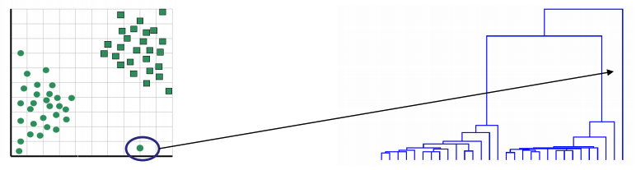
Interpreting Dendrogram
Dendrogram can be used to identify
The number of clusters in data
Well-formed clusters
Outliers

Slide 30
K-Means Clustering

Slide 31
Goal of Clustering
Given a data set 𝐷 = {𝒙₁, 𝒙₂, … , 𝒙_{𝑛}}
We need to partition 𝐷 into 𝑘 disjoint clusters, such that
Examples are self-similar in the same cluster
Examples are dissimilar across different clusters
How do we quantify this?

Slide 32
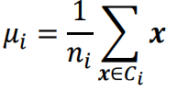
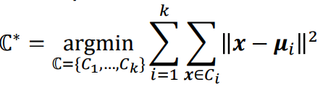
Objective: Sum of Squared Errors
Given a partition of the data into k clusters, we can compute the center (i.e., mean, center of mass) of each cluster.
For a well-formed cluster, its points should be close to its center. We measure this with sum of squared error (SSE), and formulate our objective to find a partition ℂ∗ that minimizes sum of squared error:

Slide 33
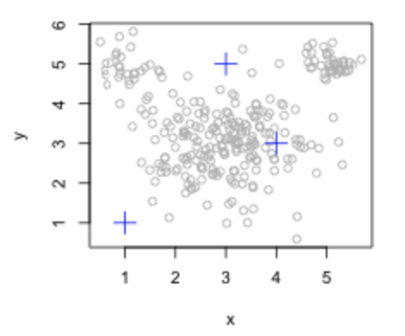
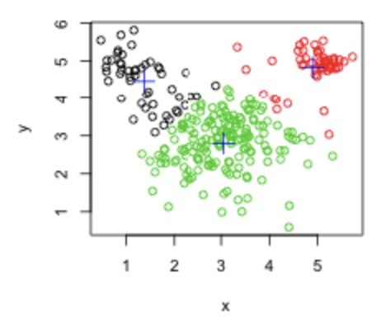
Basic Idea
We assume the number of desired clusters, k, is given.
Randomly choose k examples as seeds, one for each cluster.
Form initial clusters based on these seeds.
Iterate by repeatedly re-allocating instances to different clusters to improve the overall clustering.
Stop when clustering converges or after a fixed number of iterations.

Slide 34
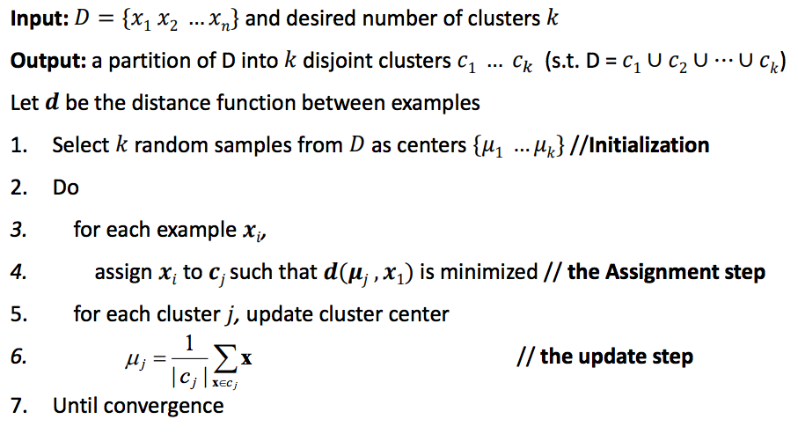
The K-means algorithm

Slide 35
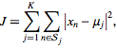
Convergence Criterions
No (or minimum) reassignments of data to different clusters
No (or minimum) change of centroids
Minimum decrease in the sum of squared error (Optimization Criteria)

Slide 36
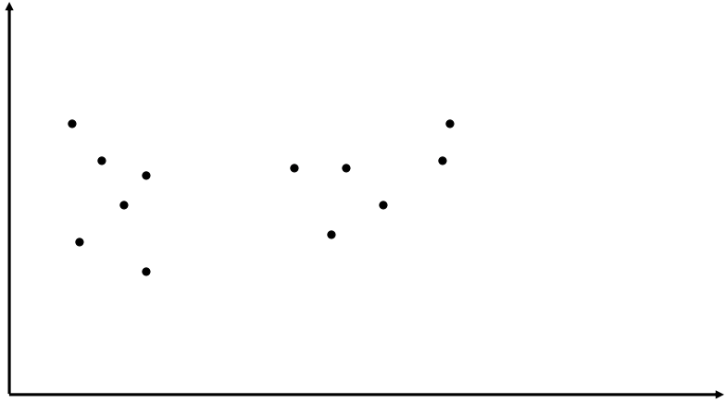
K-Means Example

Slide 37
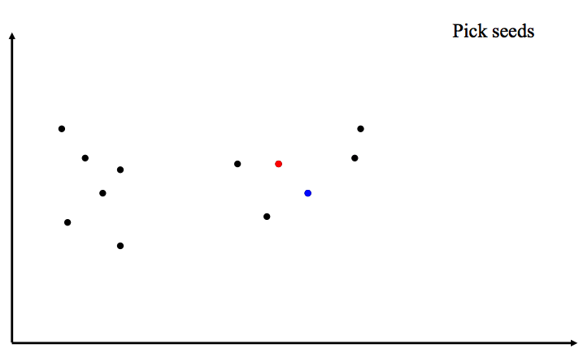
K-Means Example

Slide 38
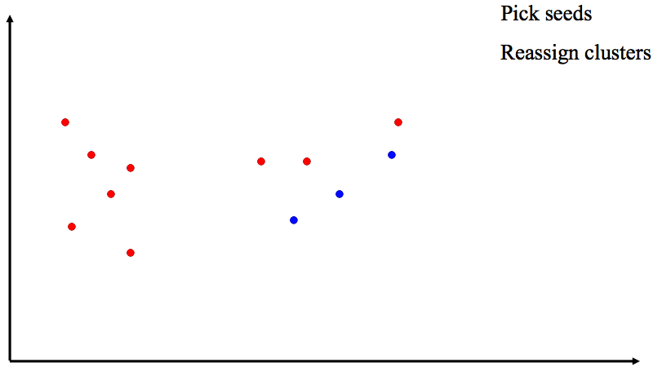
K-Means Example

Slide 39
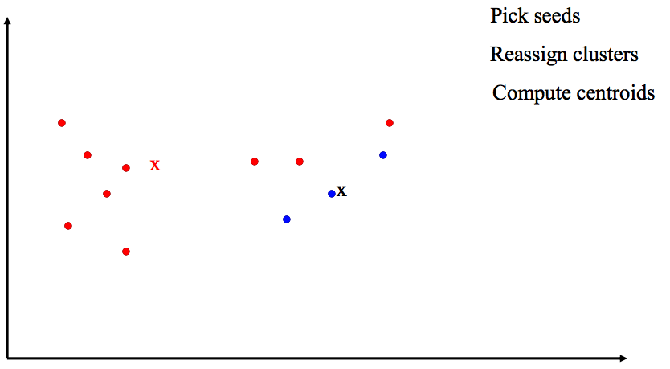
K-Means Example

Slide 40
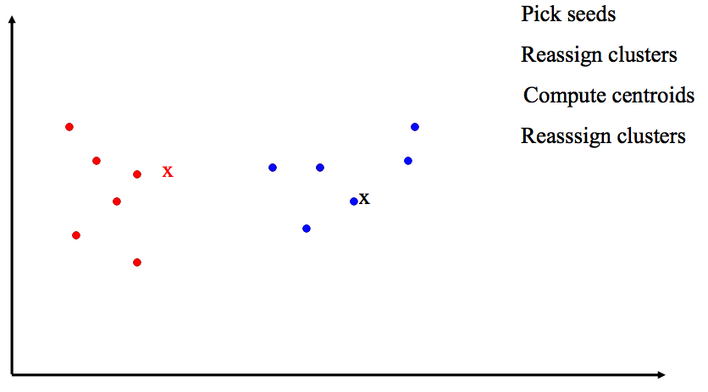
K-Means Example

Slide 41
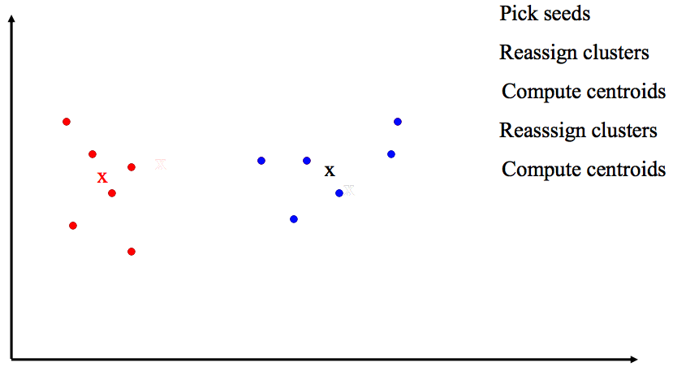
K-Means Example

Slide 42
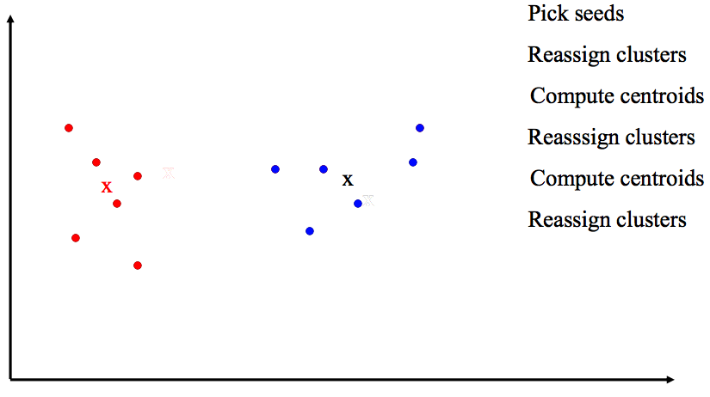
K-Means Example

Slide 43
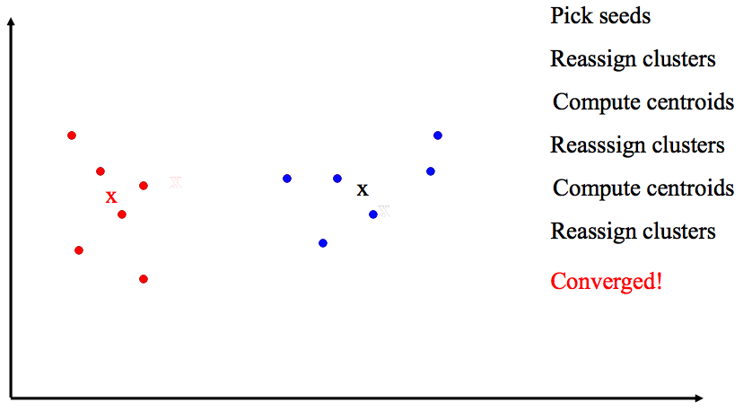
K-Means Example

Slide 44
Convergence of K-means
Monotonicity Property: Each iteration of K-means strictly decreases the SSE until convergence.
K-means always converges in a finite number of steps. Typically converges very fast.
Time complexity:
Assume computing distance between two instances is 𝑂(𝑑) where 𝑑 is the dimensionality of the vectors.
Reassigning clusters: 𝑂(𝑘𝑛) distance computations, or 𝑂(𝑘𝑛𝑑).
Computing centers: Each instance vector gets added once to some center: 𝑂(𝑛𝑑).
Assume these two steps are each done once for 𝑙 iterations: 𝑂(𝑙𝑘𝑛𝑑).

Slide 45
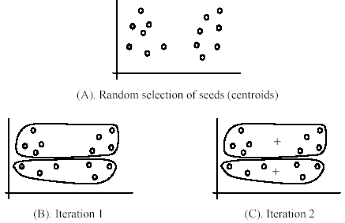
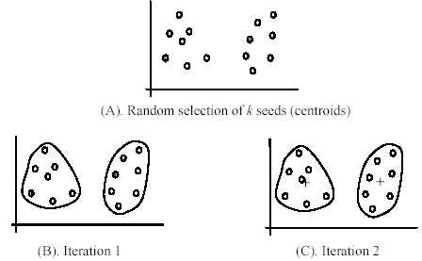
Weaknesses of K-Means: Local Minimal
K-means is very sensitive to initial conditions i.e., the initial assignment will determine the final set of clusters that one will get.
This is because SSE has many local minimal solutions.
Solutions
Run multiple trials and choose the one with the best SSE.
Heuristics. Try to choose initial centers to be far apart (e.g. K-means++).
K-means++: http://ilpubs.stanford.edu:8090/778/1/2006-13.pdf

Slide 46
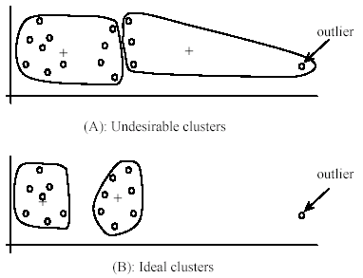
Weaknesses of K-Means: Outliers
K-means is very sensitive to outliers.
The presence of outliers can lead to very unreasonable clusters.
Solution:
Remove possible outliers before running K-means.
K-medoids

Slide 47
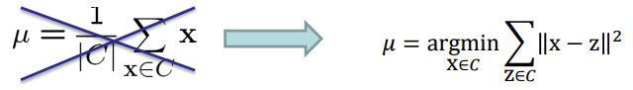
K-medoids
K-medoids – use the medoid for each cluster, i.e., the data point that is closest to other points in the cluster.
K-medoids is computationally more expensive but more robust to outliers

Slide 48
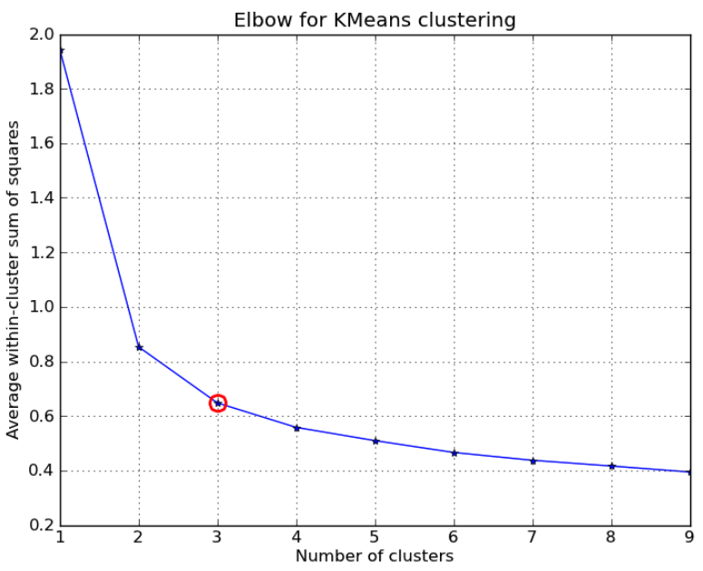
Selection of K
What if we don’t know how many clusters there are in the data?
Can we use SSE to decide k by choosing k that gives the smallest SSE?
We will always favor larger k values
Heuristic: find the knee

Slide 49
Evaluating clustering

Slide 50
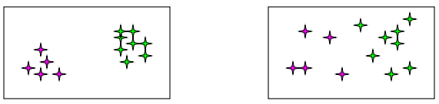
Evaluating Clusters: Internal Evaluation
By user interpretation
does a document cluster seem to correspond to a specific topic?
Internal criterion: a good clustering will produce high quality clusters
high within-cluster similarity:
Low between-cluster similarity:

Slide 51

External Indexes: Rand Index
If true class labels (ground truth) are known, the validity of a clustering can be verified by comparing the class labels and clustering labels.
Given partition (P) and ground truth (G), measure the number of vector pairs that are:
a: in the same class both in P and G.
b: in the same class in P, but in the different class in G.
c: in different classes in P, but in the same class in G.
d: in different classes both in P and G.
$$RI= \frac{a+d}{a+b+c+d}$$

Slide 52
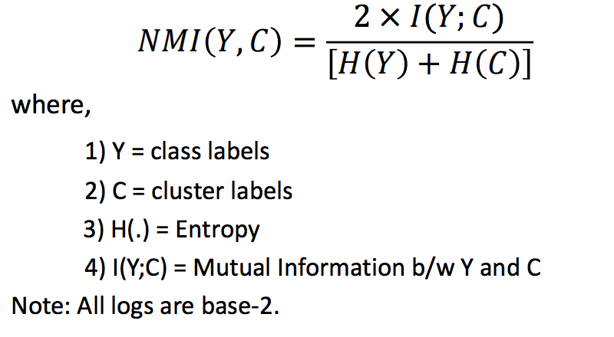
Normalized Mutual Information

Slide 53
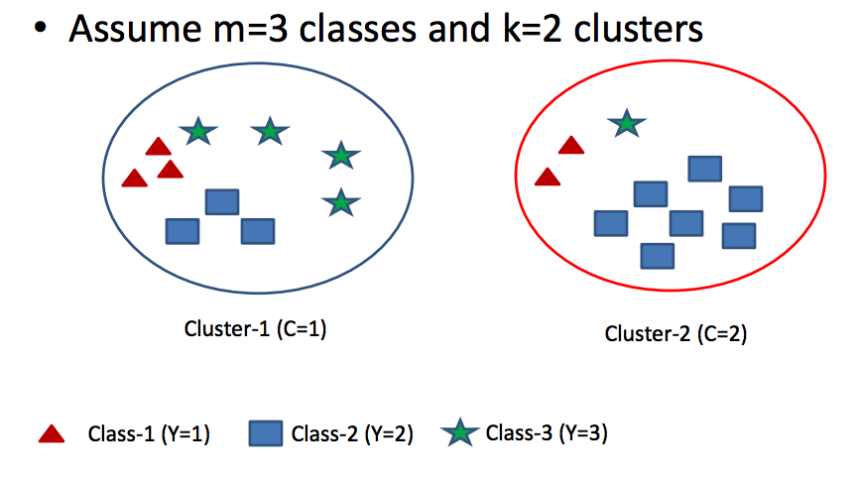
Normalized Mutual Information Example

Slide 54
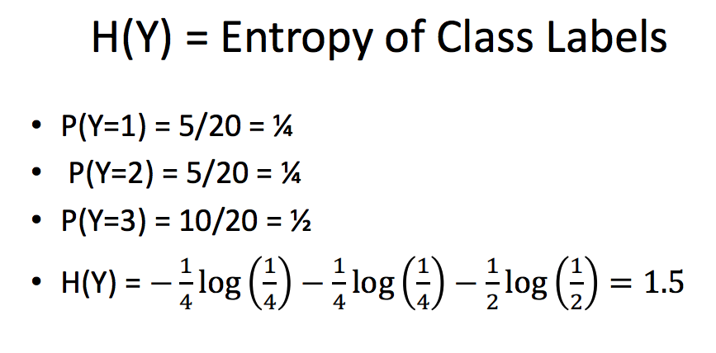
Normalized Mutual Information Example

Slide 55
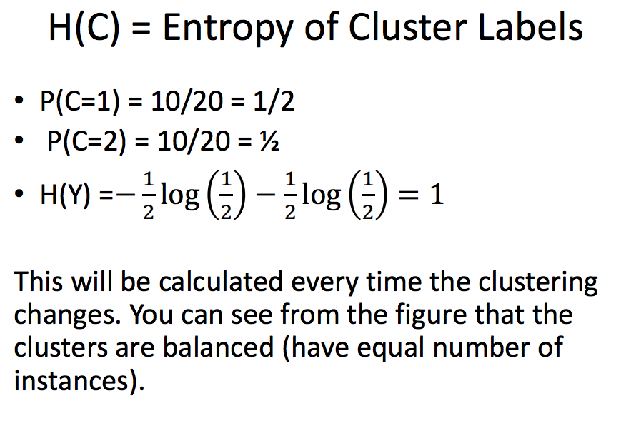
Normalized Mutual Information Example

Slide 56
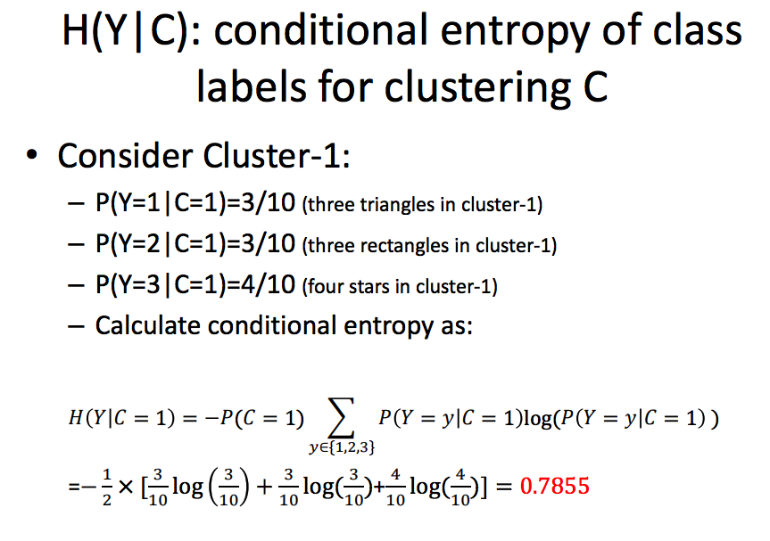
Normalized Mutual Information Example

Slide 57
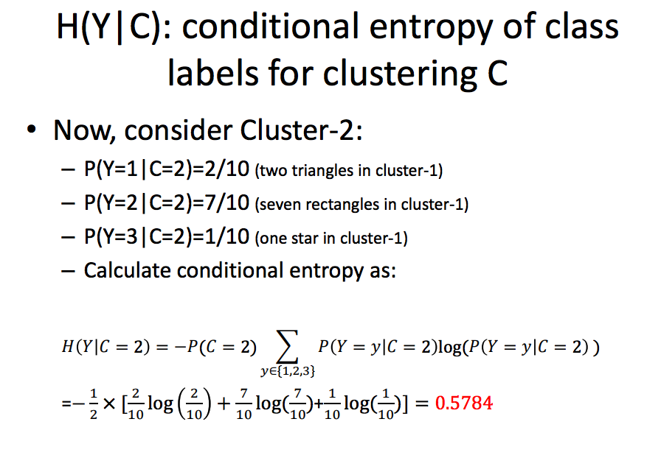
Normalized Mutual Information Example

Slide 58
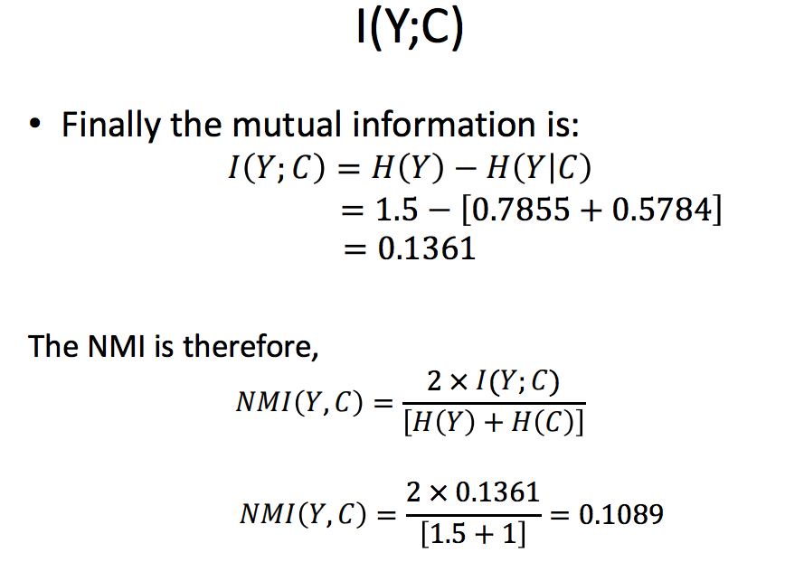
Normalized Mutual Information Example

Slide 59
Summary on Clustering Evaluation
Internal evaluation
Within-cluster similarity, larger the better
Between-cluster similarity, smaller the better
Potential issue: Dependent on how similarity is measured
External evaluation (compare against a ground truth clustering)
Rand Index (very sensitive to the number of clusters)
Normalized mutual information (less sensitive to the number of clusters)
Potential issue: there may not be only one way to cluster the data

Slide 60
Conclusion
There are a massive number of clustering algorithms.
Clustering is hard to evaluate, but very useful in practice.
Clustering is highly application dependent and to some extent subjective.
There is no one universal recipe for choosing a clustering technique and its associated parameters.

Slide 61
Appendix

